Slide 1
OBJECTS
Lecture #8
Manish Sinha

Slide 2
Topics
What is an Object?
What is a Class?
Characteristics of Objects
Constructors
Cookie Cutters
Dot Notation

Slide 3
A list of four objects and non-objects
Objects Non-objects
A pen The upper 37 % of the pen
A Computer The air above Keyboard the keyboard
A shoe The color black
A desk All desks in the world

Slide 4
Characteristics of Objects
An object has identity (it acts as a single whole).
An object has state (it has various properties, which might change).
An object has behavior (it can do things and can have things done to it).

Slide 5

Characteristics of Objects……
Consider a tube of four yellow tennis balls.
Is the tube of tennis balls an object?
Is each tennis ball an object?
Could the top two balls be considered a single object?
Is the color of the balls an object?
Is your understanding of tennis balls an object?

Slide 6
Characteristics of Objects……
Is the tube of tennis balls an object?
Yes. It has identity (my tube of balls is different than yours), it has state (opened, unopened, brand name, location), and behavior (although not much.)
Is each tennis ball an object?
Yes. It is OK for objects to be part of other objects. Although each ball has nearly the same state and behavior as the others, each has its own identity.
Could the top two balls be considered a single object?
Not ordinarily. Each has its own identity independent of the other. If they were joined together with a stick you might consider them as one object.
Is the color of the balls an object?
No. It is a property of each ball.
Is your understanding of tennis balls an object?
Probably not, although it is unclear what it is. Perhaps it is a property of the object called "your brain."

Slide 7
Software Objects
Question: What are software objects made out of?
Answer: Computer memory.
Software objects have identity because each is a separate chunk of memory
Software objects have state. Some of the memory that makes a software object is used for variables which contain values.
Software objects have behavior. Some of the memory that makes a software object is used to contain programs (called methods) that enable the object to "do things." The object does something when one of its method runs.

Slide 8
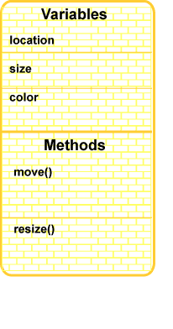
Picture of an Object
Variables: location, color,
and size.
Methods: move and resize
The methods must execute in the correct order.
For an application the first
method to run is the
method named main().
Have you seen a main() method before?

Slide 9
Class
A class is a description of a kind of object.
  A programmer may define a class
  or may use predefined classes that come in class libraries.
A class is merely a plan for a possible object (or objects.). It does not by itself create any objects.
When a programmer wants to create an object the new operator is used with the name of the class.
Creating an object is called instantiation.

Slide 10
stringTester.java
class stringTester {
public static void main ( String[] args ) {
String str1; // str1 is a variable that refers to an object,
// but the object does not exist yet.
int len; // len is a primitive variable of type int
str1 = new String(“Amitabh Bachchan"); // create an object of type //String
len = str1.length(); // invoke the object's method length() System.out.println("The string is " + len + " characters long");
}
}

Slide 11
FAQs on Objects
If a program has a name for an object, does that mean that an object really exists?
No. Just because there is a name for an object does not mean an object exists.
What object is being referred to in the statement:
len = str1.length(); // invoke the object's method length()
This statement occurs in the program after the object has been created, so str1 is that object.
Tough Question:) Is it possible for a program to have several objects all of the same class?
Yes. A class is a description of potential objects and can be used many times to make many objects of the same type. The objects do not have to have the same data inside of them, just the same over all plan.

Slide 12
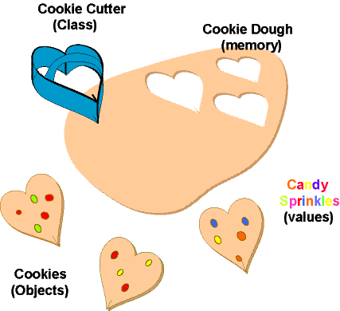
Using a Class to Make Many Objects
Class is like cookies cutters and cookies are objects. There is only one cookie cutter, but can be used to make many cookies.
Cookies can be created and cookies can be destroyed
A big cookie (such as a gingerbread house) might be built out of many smaller cookies of several different types.
Different cookies may have different characteristics, even though they follow the same basic pattern
Each cookie is made out of a different section of dough.
.

Slide 13
Constructors
A constructor has the same name as the class.
str1 = new String(“Amitabh Bhachchan"); // create an object of type //String
Constructors often are used with values (called parameters) that are to be stored in the data part of the object that is created.
In the stringTester program, the characters “Amitabh Bachchan" (not including the quote marks) are stored in the new object.
There are usually several different constructors in a class, each with different parameters. Sometimes one is more convenient to use than another, depending on how the new object's data is to be initialized. However, all the constructors of a class follow the same plan in creating an object.
Thought question:) Could a constructor be used a second time to change the values of an object it created?

Slide 14
Dot Notation
The two types of members inside of an object—variables and methods. The members of an object are accessed using dot notation.
The length() method is a member of str1. To refer to this method of the object str1 put the two together with a dot: len = str1.length();
Do you think that the following is correct?
str1.length() = 12 ; // change the length of str1

Slide 15
Practice Program
Create two String objects.
The first String will get the characters "Green eggs"
The second String will get the characters " and ham."
The program will compute the length of each string, and then
Write out the combined length of both Strings (the sum of the individual lengths.)

Slide 16
Practice Program ….
class stringlenAdd {
public static void main ( String[] args ) {
String str1; // str1 is a reference to a String object. ______ ____; // str2 is a reference to a second String object. int ______ , ______ ; // the length of str1 and the length of str2 ____ = _________________________ ; // create the first String
____ = _________________________ ; // create the second String _____ = str1.length(); // get the length of the first string
_____ = ____.________; // get the length of the second string System.out.println("The combined length of both strings is " + _________________ + " characters" ); }
}

Slide 17
Questions
Which of the following are correct?
String ant = "It was a dark and stormy night."
String bat = new( "A shot rang out in the dark.");
int cat = "123";
double dog = 45.69;

Slide 18
Answers
String ant = "It was a dark and stormy night." Correct. This is the short way of making a string.
String bat = new( "A shot rang out in the dark." ); Wrong--new needs a constructor name.
int cat = "123"; Wrong--can't initialize an int to a String
double dog = 45.69; Correct

Slide 19
Thank You !!
Questions ?
manish[AT]cse.iitb.ac.in
http://www.cse.iitb.ac.in/~manish

